Slide 1

Continuous Delivery – Deep Dive Track FY2015
David Cramer
Eran Sher
April 2014
© 2014 CA. All rights reserved.

Slide 2

Agenda
1
Overview – Key Drivers
2
Elevator Pitch
3
Review the Three Continuous Delivery Scenarios
4
Workshop
5
Key Stakeholders / Objection Handling
6
Competitive

Slide 3



DevOps is not just about Increasing # of Releases It is about Accelerating Throughput… Speed with Quality!
ACCELERATE DELIVERY
New applications
Changes to existing apps
Bug fixes
INCREASE RELIABILITY
Software is the customer experience
Quality and Performance are critical
MANAGE COMPLEXITY
Composite services and heterogeneous systems
Reduced budgets
Distributed development teams and IT partners

Slide 4

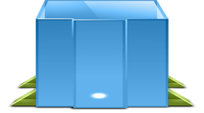
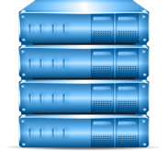




The Challenge of Today’s Complex and Dynamic IT Environment
LACK OF API TESTING (too many bugs escape downstream)
LACK OF AUTOMATED TESTING (small changes could have major unintended consequences)
LACK OF VISIBILITY INTO PROD. APPS (no visibility into the customer experience)
Code
Commit
Developer 1
Developer
Branch SCM
Code
Commit
CI Server
deploy
deploy
deploy
deploy
Developer 2
UAT/Staging
Environment
Developer
Branch SCM
Integration Lab
Production
Operations
Performance Lab
Code
Commit
LACK OF RELEASE AND ENVIRONMENT AUTOMATION (manual processes lead to poor release quality)
Developer n
Developer
Branch SCM
CI Server
Notes:
Put gear on each place we’re doing promotions

Slide 6
CA Enterprise DevOps
CONTINUOUS VALIDATION
Code
Commit
Developer 1
Developer
Branch SCM
Code
Commit
CI Server
deploy
deploy
deploy
deploy
Developer 2
UAT/Staging
Environment
Developer
Branch SCM
Integration Lab
Production
Operations
Performance Lab
Code
Commit
DATA
MINING
CONTINUOUS DELIVERY
Developer n
Developer
Branch SCM
CI Server
TRUE AGILE DEVELOPMENT
Notes:
Combine these two slides – dissolve text, replace with solutions

Slide 7

“Since implementing CA LISA Release Automation, we’ve deployed our online business into eight different countries, which wouldn’t have been possible before – that means the same team can deliver eight or nine times the volume of releases.”
TOMAS KADLEC GROUP INFRASTRUCTURE IT DIRECTOR, TESCO

Slide 8

“Gartner believes that more than 80% of all mission-critical IT service outages result from people and process errors and failures, and of those outages, more than 50% result from a lack of coordination between change, release and configuration management processes.”
G00258557 Four Steps to Optimize Configuration Management Process and Tools | Published: 31 October 2013 | Analyst(s): Ronni J. Colville

Slide 9


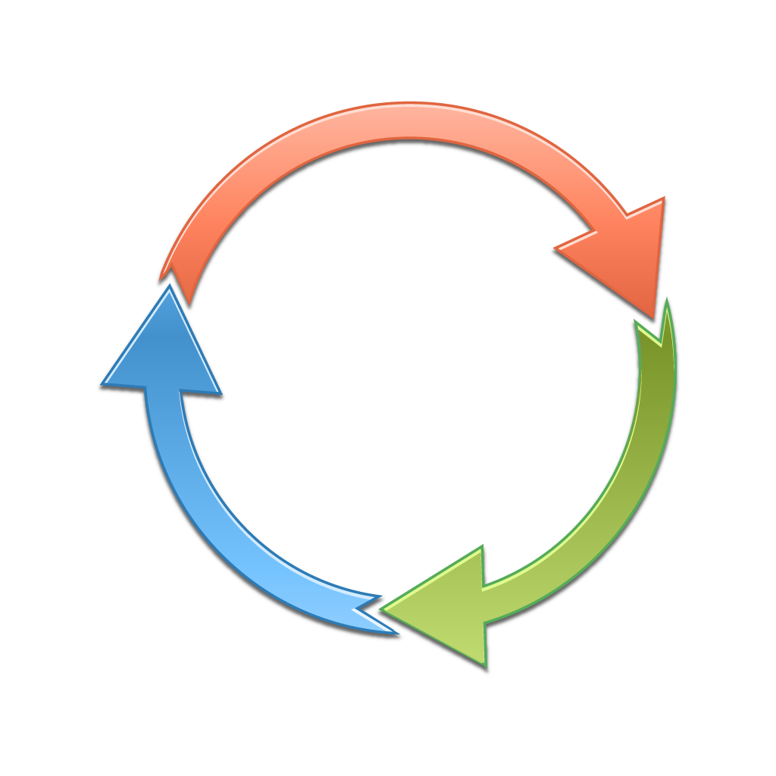
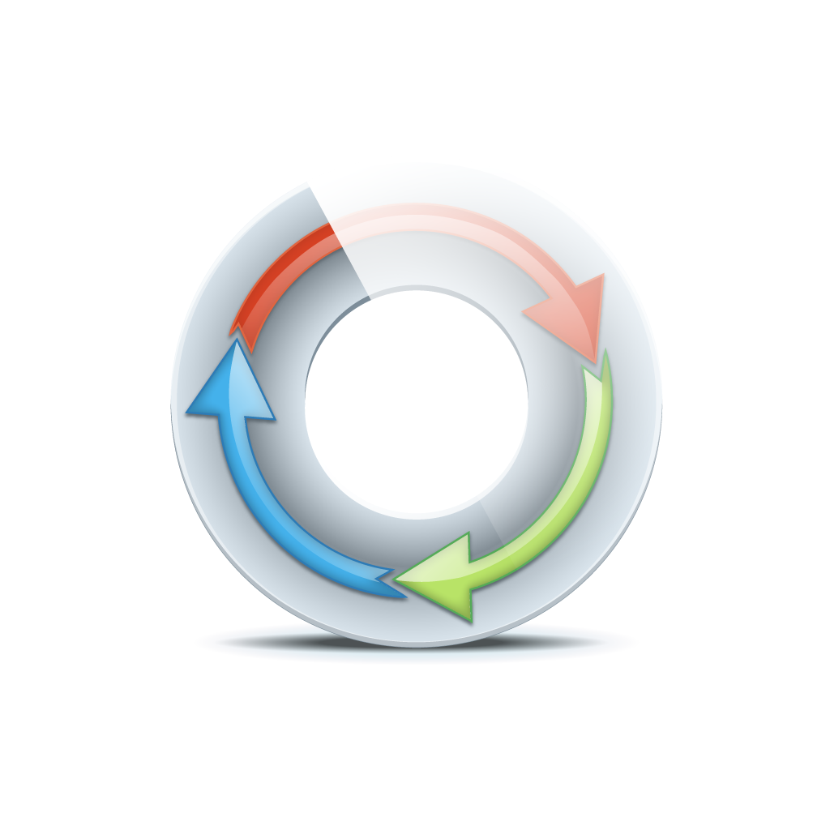


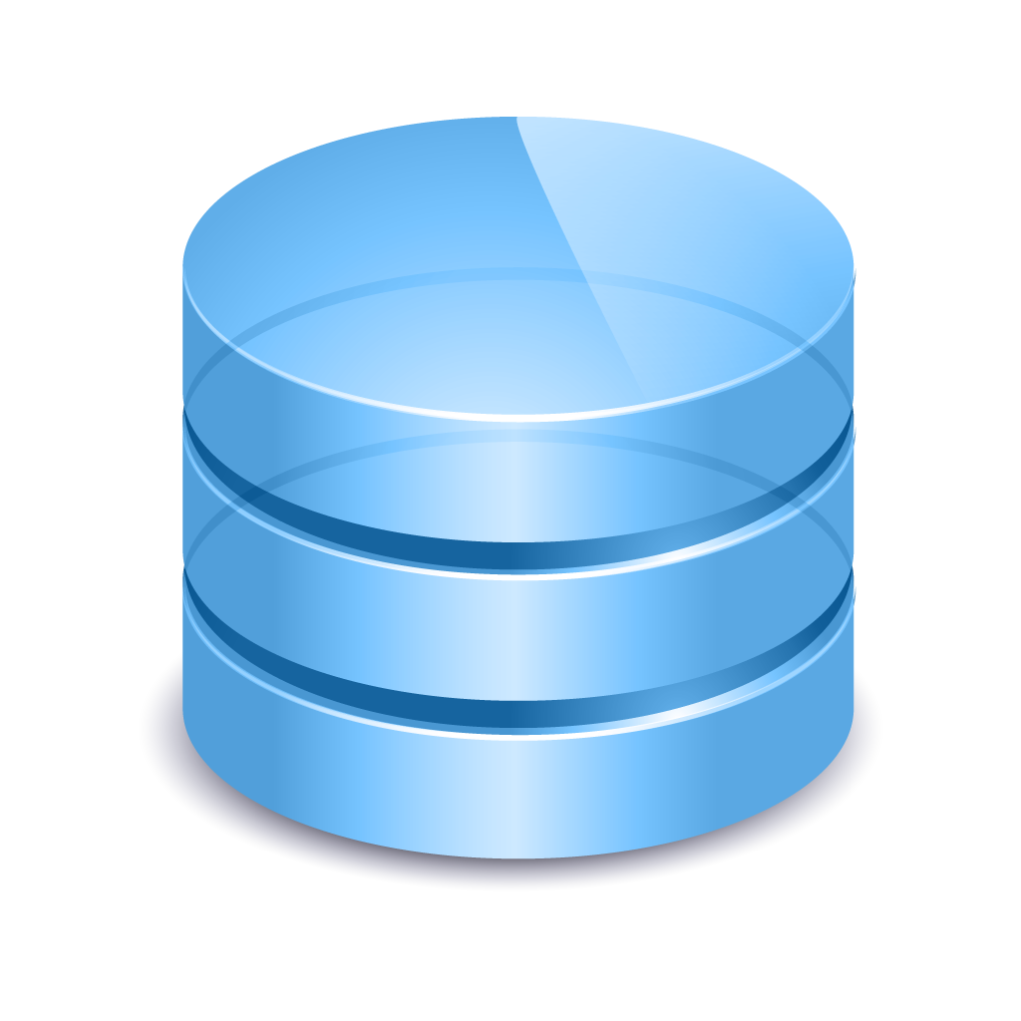
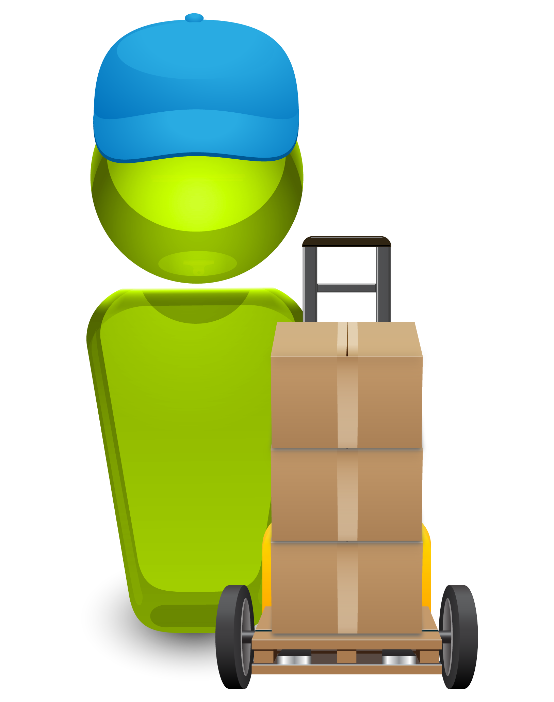
Identifying the problem
MORE INNOVATION, QUICKER, LESS COST
DAYS/MINUTES
Agile Development
Test Automation
Continuous Integration
Virtualization/Cloud
Provisioning Automation
Configuration Mgmt
CONTINUOUS DELIVERY
50%
Release Errors
Long Time To Market
High Costs
Innovation
DEV
INT
UAT
PERF
PROD
Business Value
MONTHS
Notes:
Use previous environment pics…redo
This slide discusses the state of many development and IT operations organizations today.
We start off talking about Innovation. A lot of innovation is happening on the development side. Development can create new applications and features faster than organizations can get them to production where they create real business value.
Many development teams have implemented Agile methodologies, automated testing and Continuous Integrations systems to help speed up development and unit test cycels and reduce bottlenecks on the dev side.
It Ops have implemented virtualization, cloud and infrastructure and configuration automation technologies to help speed up the provisioning of infrastructure components.
According to Gartner more than 80% of all mission-critical IT service outages result from people and process errors and failures, and of those outages, more than 50% result from a lack of coordination between change, release and configuration management processes.
All which result in delayed time-to-more and increased costs.
A Continuous Delivery solution that automates the release and deployment processes and eliminate in-house written scripts and manual processes can significantly improve the speed and quality in which applications are delivered across the entire application lifecycle – development through production.

Slide 10

CA Release Automation – Elevator Pitch
CA Release Automation helps organizations orchestrate the entire application release process and automate the deployment of applications from development into production.
Application deployment tasks are automated, errors are reduced, software releases are more reliable, and throughput is dramatically improved.
Speed up application release cycles and improve business and operational agility
Reduce errors and achieve higher quality releases by simplifying and standardizing application release processes
Enable more frequent releases and reduce risk of failure
Reduce costs of application deployments and promote collaboration and alignment between Development and Operations
Improve visibility across the entire deployment tool chain

Slide 11
Release Automation and Orchestration

Slide 12
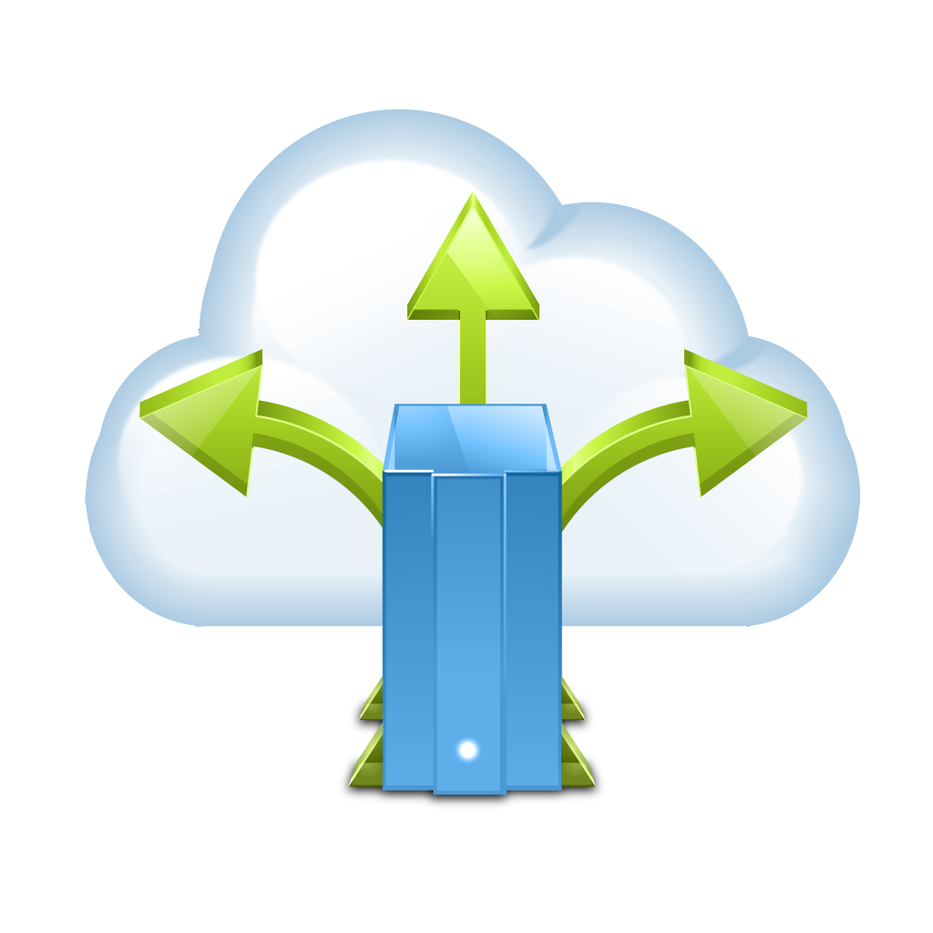
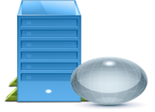
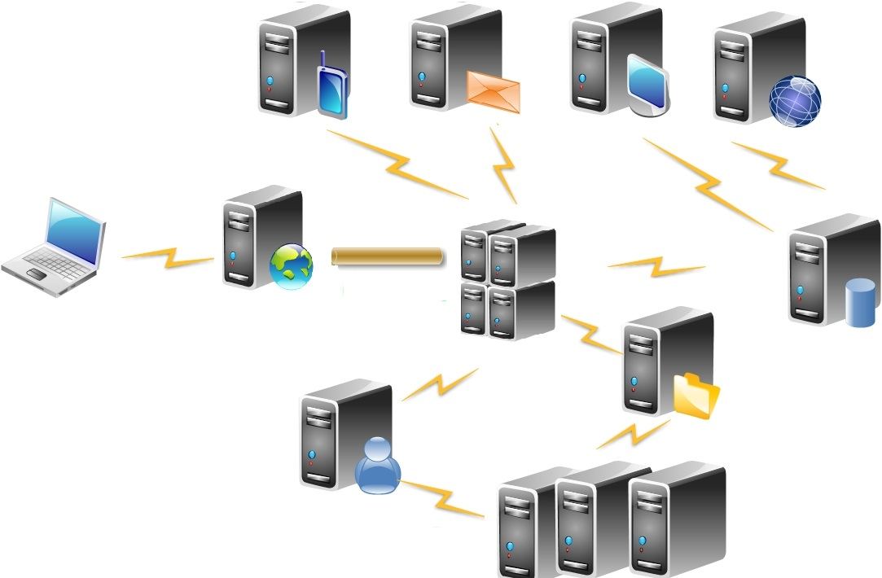


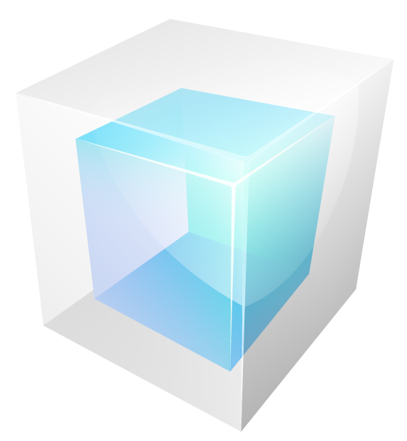

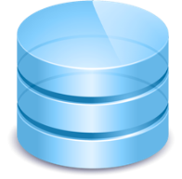


A Unique Approach to Release Automation
CONTINUOUS DELIVERY
ENVIRONMENT DATA
APPLICATION MODEL
Architectures Server-Types
Deployment Logic Flows & Process
Environment Resources
Environment Configuration
RELEASE DATA
MANIFEST DRIVEN DEPLOYMENTS
Application
Artifacts
Release
Type
Application
Configuration
Notes:
Release data: artifacts for release, release type (full, partial, hot fix), rollback logic, application config
Show same set of environments as other slides

Slide 13
A Unique Approach to Release Automation
CONTINUOUS DELIVERY
ENVIRONMENTS DATA
APPLICATION MODEL
RELEASE DATA
MANIFEST DRIVEN DEPLOYMENTS
Manifest
Manifest
Manifest
Manifest
INT
UAT
PERF
PROD
PROMOTE
PROMOTE
PROMOTE
Notes:
Release data: artifacts for release, release type (full, partial, hot fix), rollback logic, application config
Show same set of environments as other slides

Slide 14









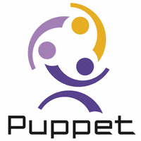
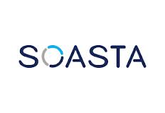



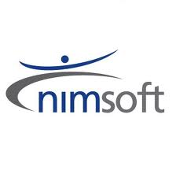


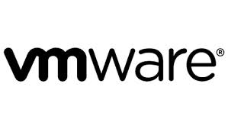
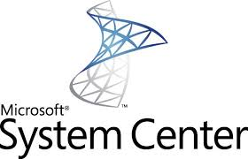
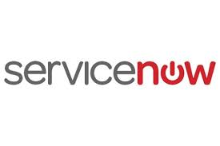
Continuous Delivery Tool Chain
ARTIFACT REPOSITORY
CONTINUOUS INTEGRATION
BUILD AUTOMATION
TEST AUTOMATION
CONFIGURATION MANAGEMENT
Application Model
Environment Data
CHANGE MANAGEMENT
INFRA PROVISIONING
MANIFEST DRIVEN DEPLOYMENTS
Release Data
INT
UAT
PERF
PROD
Notes:
Key use cases:
Continuous Integration systems
Artifact Repository
Services Desk
Approvals, change management
Automated test, service virtualization
Configuration Management
Cloud Provisioning

Slide 15
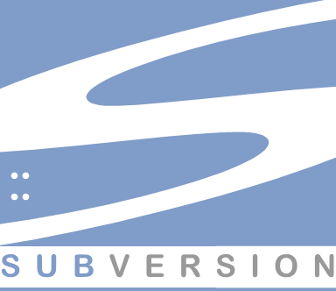
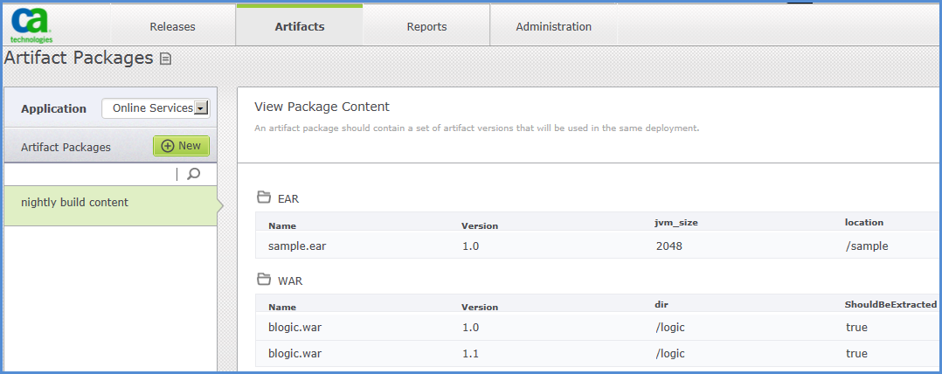
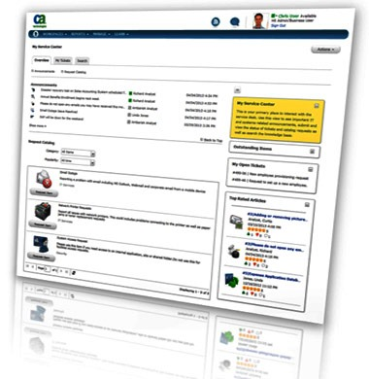
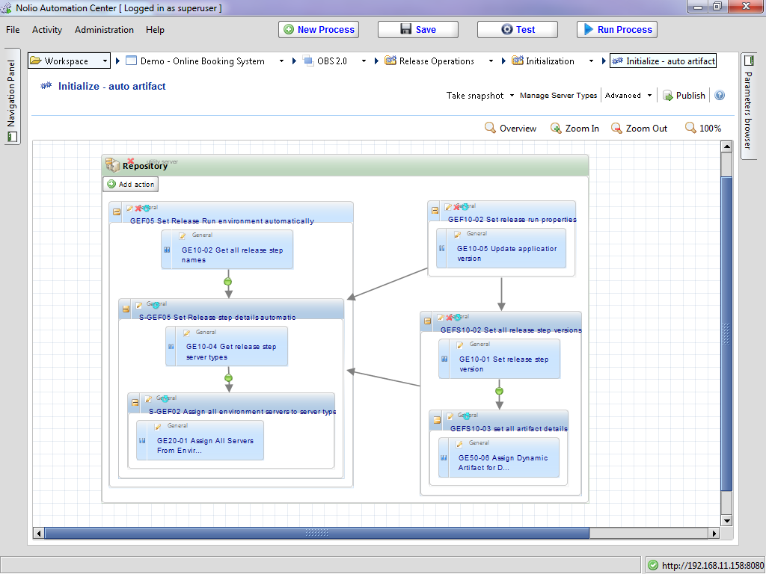
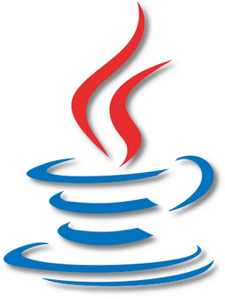
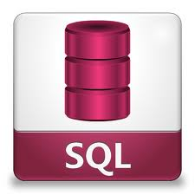



Release Automation Scenario
Create Release
1
Release Operations Center
Service Desk
Retrieve SQL & CFG
Retrieve
Artifacts
2
7
Run Initialize Process
Approval Gate
Retrieve WAR
4
Run Deployment Processes
Stage Artifacts
3
Network Share
Pre Deploy
Verification
Configure BigIP F5
Deploy
Jetty/WAS App
Deploy
Database
Post Deploy
Verification
STEP 1
STEP 2
STEP 3
STEP 4
STEP 5
Deployment
Deployment
Deployment
Deployment
Env
Config
Env
Config
Env
Config
Env
Config
INT
UAT
5
PERF
6
PROD
8

Slide 16
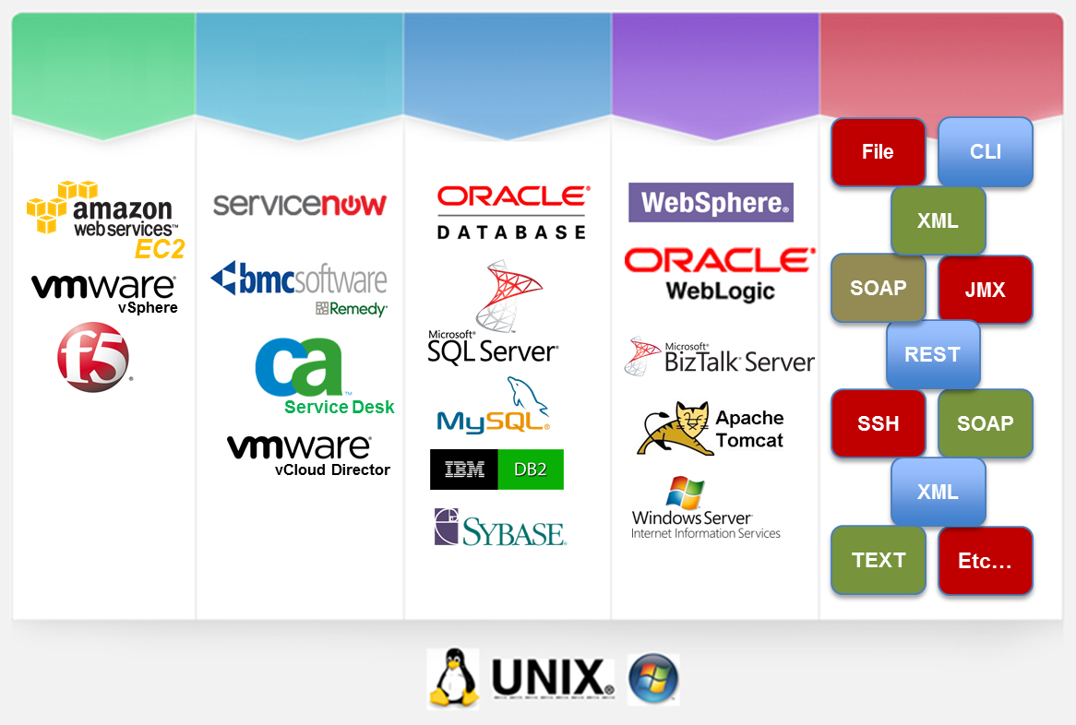
Enterprise Solution with strong ecosystem integrations
BROAD ECOSYSTEM INTEGRATION WITH OVER 1200+ ACTIONS AND 50 INTEGRATIONS AVAILABLE
Integrations to many enterprise software solutions for IT Development, Operations and Service Management
Out-of-the-Box and ready to use with no scripting required
Rapid Development Kit for quick, consistent integration code generation and packaging
Notes:
CA Release Automation enables our customers to leverage there existing investment with 1000s of available actions for out of the box integrations to the leading ALM, ITSM and CMDB solutions in addition the most prevalent application, web and databases server technologies.

Slide 17
Environment Management

Slide 18
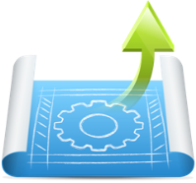
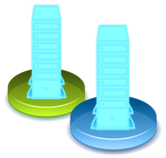



CA Cloud Manager Overview
A consolidated platform to enable on-demand, self-service cloud platform provisioning and management.
Standardize Platforms
PROVISION
SECURE
CA CLOUD
MANAGER
Environment as a Service
MANAGE
GOVERN
Cloud Portability
Notes:
NOTES:
Our cloud management platform focuses on the higher-level application-centric aspects of cloud management… and encompasses the Service Optimization, Service Management and Access Management layers. In fact, we extend this framework further to encompass application-centric governance, policy, and lifecycle management capabilities. We also believe that Security needs to be systemic across this solution stack and we provide capabilities to control and enforce security throughout…not just a the Resource Management layer for example.
Another thing to note, is that Cloud Manager is complementary to many of these other Cloud Implementation products. Cloud Manager doesn’t try to implement the Resources or Resource Management layers on its own. In fact, the solution was always architected to work with multiple heterogeneous clouds, both public and private… and provide workload portability across them.
Application-centric delivery, orchestration, and governance raise the bar. This takes you out of the realm of “IT Ops” and into the larger Software Development Lifecycle (SDLC). There are many more touch points and dependencies involved here. And it means you need a platform solution that can help you address additional challenges like:
Removing barriers and silos across the SDLC… that significantly delay cycle times.
Its about standardizing around on-demand, self-service IT portfolio offerings. Not a narrow discussion around IaaS or PaaS in isolation. Its about an everything-as-a-service model where you provide a fully governed, standardized portfolio of offerings to the business to address a range of needs.
It means integrating and leveraging the existing IT vendor ecosystem to achieve a high degree of automation.
It means leveraging a federation of different types of clouds (not just a private cloud, and a public cloud), to get an optimal balance of economic value, scale, and performance for all your cloud use cases.
These are some of the broader challenges CA LISA Cloud Manager is out to solve. And they are definitely messier…. But if you can successfully address them, you open up the much more strategic benefits to transform IT that we discussed earlier.

Slide 19


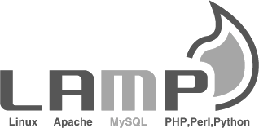

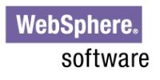






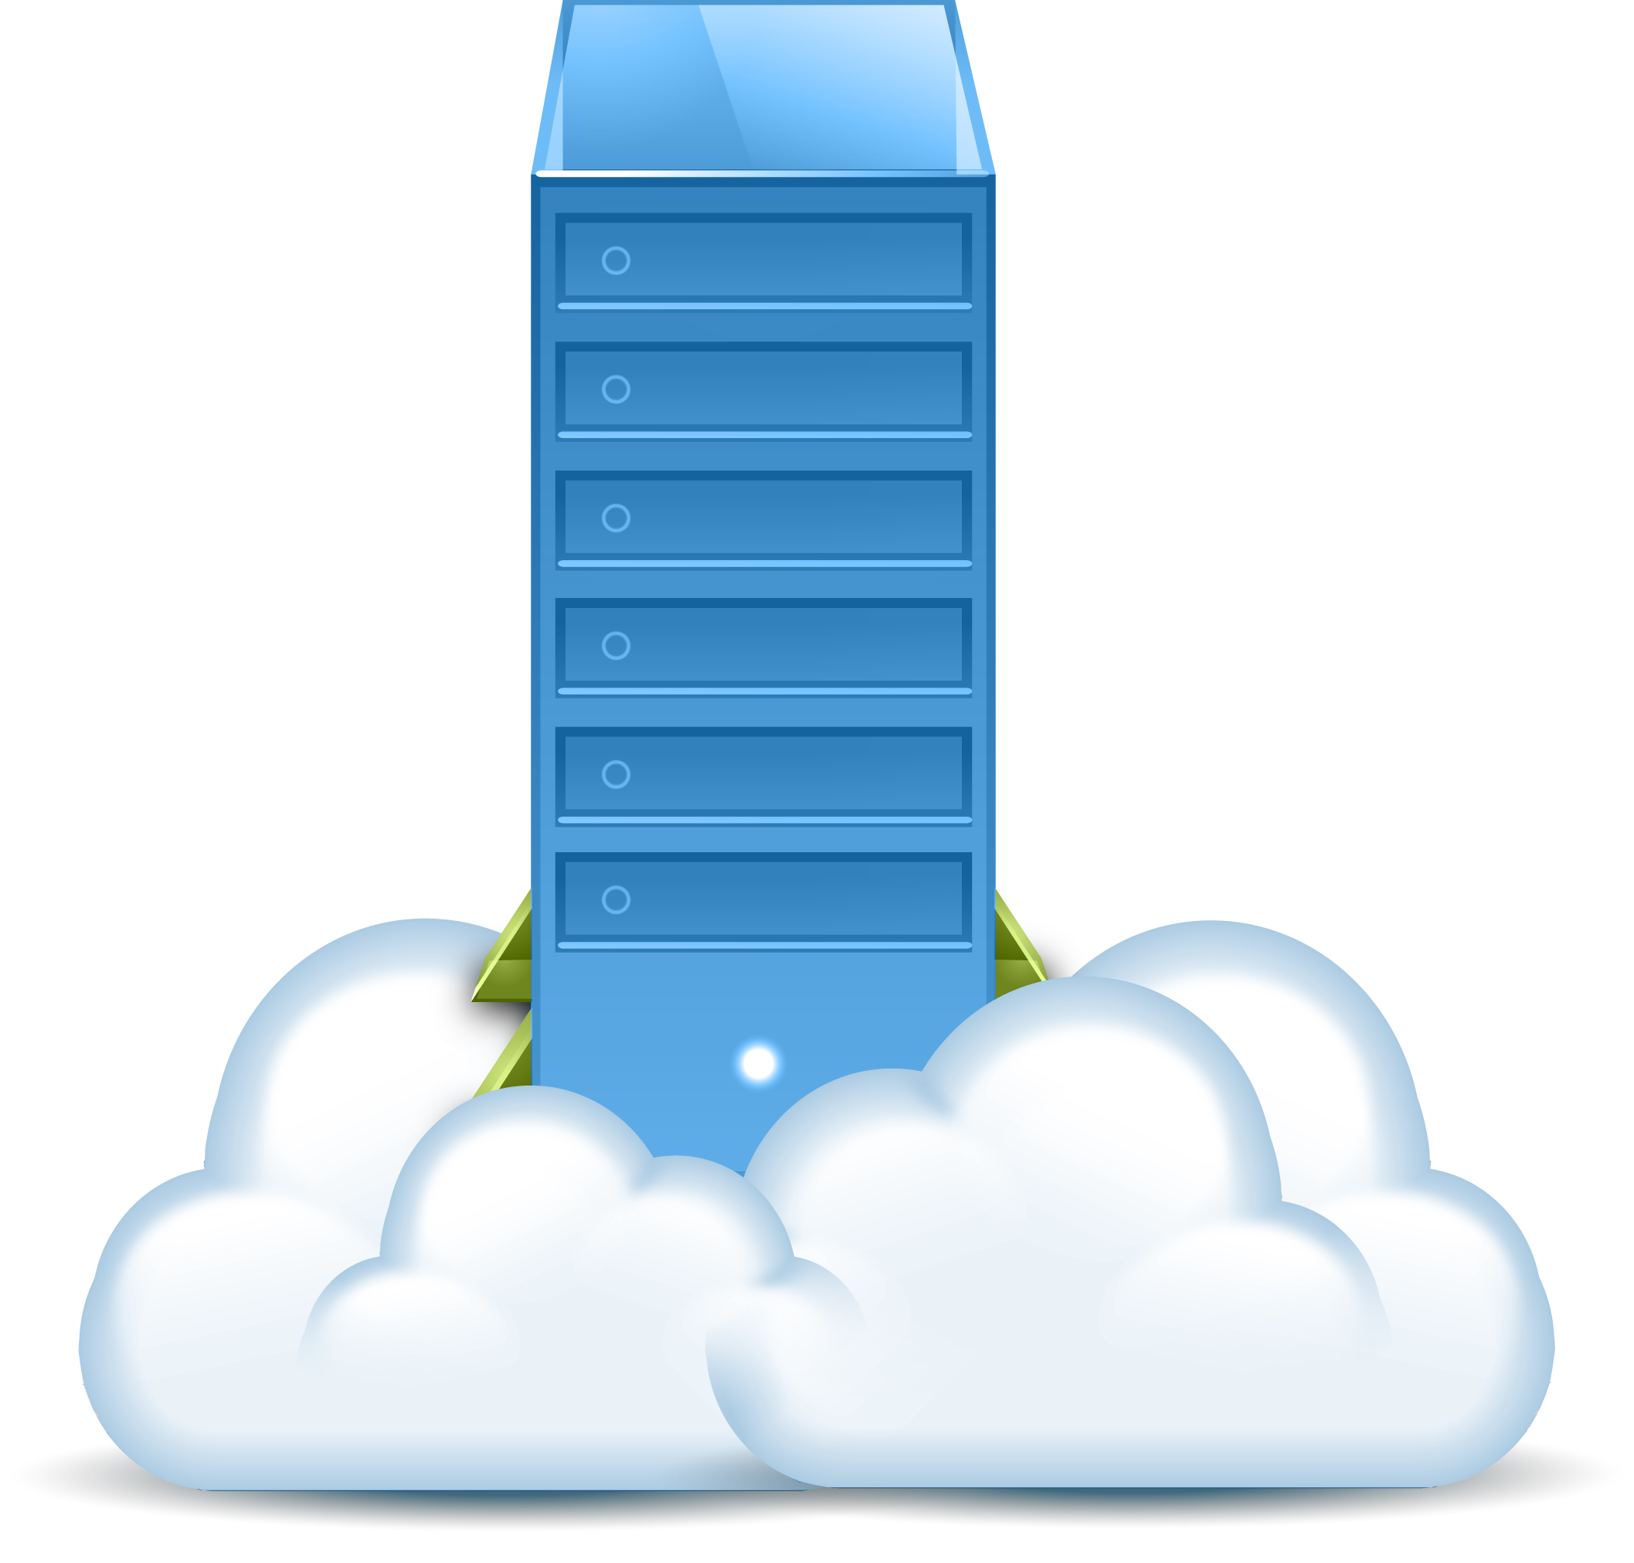
Policy-driven Governance Is An Enterprise Requirement
WITHOUT POLICIES:
WITH POLICY-DRIVEN GOVERNANCE AND ORCHESTRATION
GOVERNANCE AND LIFECYCLE MANAGEMENT
Wrong Permissions
Approval Delays
Policies control access to self-service resources
Unsecured Data
No Audit Trail
Wrong Environment
Policies optimize placement of workloads
Notes:
More people are realizing the importance of cloud governance.
Without effective governance, users could deploy workloads to the wrong place, or with the wrong security posture, or a variety of other things could go wrong and get you in hot water with auditors, and others. (Shown on the Left)
So how do you provide effective governance?.... (Shown on the Right)

Slide 20

Example: Custom Policy Creation And Enforcement Drives End-to-end Automation
START
SDLCs
Design
Develop
Test
UAT
Operate
Credentials verified: Policies will be enforced based on user’s role, group, and project.
FEDERATED IDENTITY MANAGEMENT
POLICY MANAGEMENT / GOVERNANCE
Extensible Meta Model
VERSIONED ASSET REPOSITORY
Workflow
Security
Common App Platforms
Other Assets
Other Assets
Other Assets
Metering
Monitoring
Workload Provisioning / Orchestration / Scheduling
EXAMPLE SCENARIO:
U.K. Developer in Retail Banking Group requests a dev platform
INTERNAL PRIVATE
EXTERNAL PRIVATE
SECURE PUBLIC
Notes:
NOTES: One last important point I want to make regarding our policy-driven governance capabilities, is that all of this is built on top of an extensible Policy Engine. And what that really means is that Cloud Manager is architected in such a way that you can create and enforce a nearly unlimited variety of your own custom policies.
This slide build I’m about to show you is an example of enforcing one set of policies for a Developer desktop use case. In this use case, we’ll enforce several complementary policies…which is quite common.
In this scenario… we’re looking at a Developer in the UK that is requesting a development environment for one of his projects so he can do his work.
--First step, is verifying his credentials with Agility Access, which is a Federated Identity Mgmt module that integrate with Active Directory, LDAP, and other directories. This will verify which role, project, and permissions are appropriate for this user, and can also provide SSO access across different services if appropriate.
===================================
--Based on that, he’ll be granted access to a repository of the various platforms and assets approved for his use. From there, he can chose to deploy a platform with a single click.
--Based on the sensitivity of the developer’s project and the data he’s using, his environment will be provisioned to the appropriate pre-defined security zones… which can encompass automatically configuring firewall rules, anti-virus, HIDS, and more.
--Based on regulatory constraints at the business or industry level and the type of customer data he may be working with, a policy will restrict his deployments only to specific approved geographies.
--Finally, as provisioning proceeds, a policy will restrict this particular user in terms of the number of machines or resources he can provision.
--And lastly, from a monitoring perspective, IT Ops requires deployment of their preferred monitoring agent on each workload so that they can monitor activity and usage, and release any VM that is inactive for more than 72 hours.

Slide 21
Example: Custom Policy Creation And Enforcement Drives End-to-end Automation
START
SDLCs
Design
Develop
Test
UAT
Operate
Credentials verified: Policies will be enforced based on user’s role, group, and project.
Policy #1: Access granted to platforms approved for Retail Banking projects.
FEDERATED IDENTITY MANAGEMENT
POLICY MANAGEMENT / GOVERNANCE
Extensible Meta Model
VERSIONED ASSET REPOSITORY
Workflow
Security
Common App Platforms
Other Assets
Other Assets
Other Assets
Metering
Monitoring
Workload Provisioning / Orchestration / Scheduling
EXAMPLE SCENARIO:
U.K. Developer in Retail Banking Group requests a dev platform
INTERNAL PRIVATE
EXTERNAL PRIVATE
SECURE PUBLIC
Notes:
--(1st policy) Based on that, he’ll be granted access to a repository of the various platforms and assets approved for his use. From there, he can chose to deploy a platform with a single click.

Slide 22
Example: Custom Policy Creation And Enforcement Drives End-to-end Automation
START
SDLCs
Design
Develop
Test
UAT
Operate
Credentials verified: Policies will be enforced based on user’s role, group, and project.
Policy #1: Access granted to platforms approved for Retail Banking projects.
FEDERATED IDENTITY MANAGEMENT
POLICY MANAGEMENT / GOVERNANCE
Policy #2: Deploy only to security zones approved for this project.
Extensible Meta Model
VERSIONED ASSET REPOSITORY
Workflow
Security
Common App Platforms
Other Assets
Other Assets
Other Assets
Metering
Monitoring
Workload Provisioning / Orchestration / Scheduling
EXAMPLE SCENARIO:
U.K. Developer in Retail Banking Group requests a dev platform
INTERNAL PRIVATE
EXTERNAL PRIVATE
SECURE PUBLIC
Notes:
--(1st policy) Based on that, he’ll be granted access to a repository of the various platforms and assets approved for his use. From there, he can chose to deploy a platform with a single click.

Slide 23
Example: Custom Policy Creation And Enforcement Drives End-to-end Automation
START
SDLCs
Design
Develop
Test
UAT
Operate
Credentials verified: Policies will be enforced based on user’s role, group, and project.
Policy #1: Access granted to platforms approved for Retail Banking projects.
FEDERATED IDENTITY MANAGEMENT
POLICY MANAGEMENT / GOVERNANCE
Policy #2: Deploy only to security zones approved for this project.
Extensible Meta Model
VERSIONED ASSET REPOSITORY
Workflow
Security
Common App Platforms
Other Assets
Other Assets
Other Assets
Metering
Policy #3: Regulatory constraint to deploy to UK environments only
Monitoring
Workload Provisioning / Orchestration / Scheduling
EXAMPLE SCENARIO:
U.K. Developer in Retail Banking Group requests a dev platform
INTERNAL PRIVATE
EXTERNAL PRIVATE
SECURE PUBLIC
Notes:
--(1st policy) Based on that, he’ll be granted access to a repository of the various platforms and assets approved for his use. From there, he can chose to deploy a platform with a single click.

Slide 24
Example: Custom Policy Creation And Enforcement Drives End-to-end Automation
START
SDLCs
Design
Develop
Test
UAT
Operate
Credentials verified: Policies will be enforced based on user’s role, group, and project.
Policy #1: Access granted to platforms approved for Retail Banking projects.
FEDERATED IDENTITY MANAGEMENT
POLICY MANAGEMENT / GOVERNANCE
Policy #2: Deploy only to security zones approved for this project.
Extensible Meta Model
VERSIONED ASSET REPOSITORY
Workflow
Security
Common App Platforms
Other Assets
Other Assets
Other Assets
Metering
Policy #3: Regulatory constraint to deploy to UK environments only
Policy #4: Max. instance limit enforced for this user.
Monitoring
Workload Provisioning / Orchestration / Scheduling
EXAMPLE SCENARIO:
U.K. Developer in Retail Banking Group requests a dev platform
INTERNAL PRIVATE
EXTERNAL PRIVATE
SECURE PUBLIC
Notes:
--(1st policy) Based on that, he’ll be granted access to a repository of the various platforms and assets approved for his use. From there, he can chose to deploy a platform with a single click.

Slide 25
Example: Custom Policy Creation And Enforcement Drives End-to-end Automation
START
SDLCs
Design
Develop
Test
UAT
Operate
Credentials verified: Policies will be enforced based on user’s role, group, and project.
Policy #1: Access granted to platforms approved for Retail Banking projects.
FEDERATED IDENTITY MANAGEMENT
POLICY MANAGEMENT / GOVERNANCE
Policy #2: Deploy only to security zones approved for this project.
Extensible Meta Model
VERSIONED ASSET REPOSITORY
Workflow
Security
Common App Platforms
Other Assets
Other Assets
Other Assets
Metering
Policy #3: Regulatory constraint to deploy to UK environments only
Policy #4: Max. instance limit enforced for this user.
Monitoring
Workload Provisioning / Orchestration / Scheduling
Policy #5: Monitor for inactivity and release after 72 hours.
EXAMPLE SCENARIO:
U.K. Developer in Retail Banking Group requests a dev platform
INTERNAL PRIVATE
EXTERNAL PRIVATE
SECURE PUBLIC
Notes:
--(1st policy) Based on that, he’ll be granted access to a repository of the various platforms and assets approved for his use. From there, he can chose to deploy a platform with a single click.

Slide 26





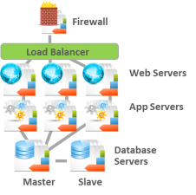


Continuous Delivery – Total Integrated Solution Orchestrating and Accelerating the Software Development Lifecycle
Develop
Test
CONTINUOUS DELIVERY
UAT
Prod
Increase speed/frequency of software releases
Automate workflow across existing tool chains
Automate application release and promotion
CA Release Automation
INTERNAL
PRIVATE
INTERNAL
PUBLIC
SECURE
PUBLIC
On-demand platforms and environments that end-users need
Governance, visibility, and cost transparency that managers require
Leverage hybrid clouds and enable cloud portability
Blueprint
Blueprint
Blueprint
CA Cloud Manager
Notes:
NOTES:
In summary…the combination of Release Automaton, environment blueprints, and policy controls can enable you to orchestrate and automate significant portions of your SDLC… which will increase the speed and frequency of software releases… a critical aspect of improving your business agility.
That’s essentially what is illustrated here…. Showing the app toolchain up top, integrated directly with CA Release Automation and the deployment environments - which are modeled with blueprints and governed via policy, and then deployed into your preferred public or private clouds while remaining infrastructure independent and cloud portable

Slide 27
Configuration Management

Slide 28
Configuration Management Solutions
Strengths are infrastructure provisioning and configuration management; not release automation and continuous delivery
Focus is on automating IT infrastructure tasks including: discovery, provisioning, OS & app configuration management, orchestration and reporting
Typically very complex products that requires specific expertise which are in short supply and costly
Have few out-of-the-box features for release automation/application deployment. For example, they do not: Deploy code, do pre-flight validation, do auto-promotion, have analytics, have approval gates, have process coordination, have reporting or dashboards

Slide 29
thank you

Slide 30
© 2014 CA. All rights reserved.

Slide 31
backup

Slide 32
Stakeholders & Objection Handling

Slide 33
Customer Champions & Stakeholders
VP DEVELOPMENT/ APPS AND ENTERPRISE ARCHITECTS
VP OPERATIONS, DEVOPS/RELEASE MANAGER
LINE OF BUSINESS OWNER (LBO)
Driven by meeting/exceeding project goals; faster time to market; meeting/exceeding quality metrics
Driven by meeting/exceeding deployment goals; increasing productivity; improving operational efficiencies
Driven by accelerating time to market; meeting business/financial metrics; reducing risk & cost; business enablement

Slide 34
Qualifying Questions
1
How long does it take to release an application?
2
What are the most challenging aspects of your application deployment process today?
3
Please describe your overall change and release processes.
4
What strategic initiatives are driving the demand for increased business and operational agility?
What are your current release times or frequency of development/test/stage/production deployments?
5
How do you run your application deployments today? How much of that are manual or scripts based?
6
Which organization or key personnel are involved in deployment across each of the Development, Test, Stage, and Production environment?
7

Slide 35
Objection Handling
“We have written in-house scripts that are handling our release processes.”
My organization is too immature – we don’t have the structure in our organization to consume this technology.
It seems like it will be difficult to get the different teams to work collaboratively?
“We have Puppet/Chef and they say they can do release automation?”
“We using Hudson and TFS already to automate our release processes.”
Every application we have is different, we will not be able to benefit from your standardization.
“Our team is not large enough for benefitting from a tool like LISA RA..”
Your solution is too expensive for our needs

Slide 36
Competitive

Slide 37
Competitive Advantages
MANIFEST DRIVEN DEPLOYMENTS simplify and streamline application releases by allowing users to design a release process and use that process for multiple application/environment combinations
COMPREHENSIVE ACTION PACK LIBRARY enables customers to integrate leading 3rd party solutions without scripting
SCALABLE ENTERPRISE SOLUTION that is designed to handle complex, multi-tier releases across tens of 1000s of servers and across multiple teams
INTUITIVE, GRAPHICAL WORKFLOW ENGINE eliminates the need for scripting and quickly allows you to visually create reusable deployment processes
SUPPORT FOR MULTI-TIER, APPLICATION RELEASE allows customers to define and manage very complex deployments that span multiple applications, environments and all the components of the release process

Slide 38
Product Competition Matrix
Competitor | Strengths | Weaknesses | How to beat
IBM UrbanCode Release & Deploy | Ease of use Integrations/Plug-ins Roots in development with build management | Easy but rigid deployment model No Manifest Driven deployment Limited workflow functionality | Stress Manifest Driven capabilities Leverage strength of Create FUD of IBM Vendor lock-in Leverage Full Application Delivery Solution
Automic (UC4) | Mature Automation Backend WA Customer Base Configuration Management Solution for SAP | Mature Automation Backend WA Customer Base Configuration Management Solution for SAP | Stress graphical workflow engine – no scripting Manifest capabilities – reusable processes CA Cloud Manager for environment management
XebiaLabs DeployIT | Good presence in dev community Stresses agentless technology as an advantage | Agentless implementation is less secure, less scalable Small company, immature product | Stress graphical workflow engine – no scripting Manifest capabilities – reusable processes CA Cloud Manager for environment management
BMC Application Management Suite | WebSphere/WebLogic Actions Management layer for provisioning, cloud management, ITSM | Release Automation done through scripting Lack of focus Separate products/complicated implementation | Stress graphical workflow engine – no scripting Manifest capabilities – reusable processes CA Cloud Manager for environment management
STRENGTHS
WEAKNESSES
HOW TO BEAT

Slide 39
Competitive Landscape
SOFTWARE VENDOR SOLUTIONS
IBM UrbanCode Deploy, UrbanCode Release
Strongest Competitor: Ease of use, Integrations/Plug-ins, Roots in development with build management
Automic (formerly UC4) Application Release Automation
Roots are in Job Scheduling and Workload Automation
XebiaLabs Deployit
Stresses their agentless technology,
BMC Application Management Suite
Three separate products, Heavily scriptbased, lack of focus
HP Continuous Delivery Automation
No real release management or deployment capability, more of a modeling tool

